Slide 1


Slide 2
Distributed Database Concepts
A transaction can be executed by multiple networked computers in a unified manner.
A distributed database (DDB) processes Unit of execution (a transaction) in a distributed manner. A distributed database (DDB) can be defined as
  A distributed database (DDB) is a collection of multiple logically related database distributed over a computer network, and a distributed database management system as a software system that manages a distributed database while making the distribution transparent to the user.

Slide 3
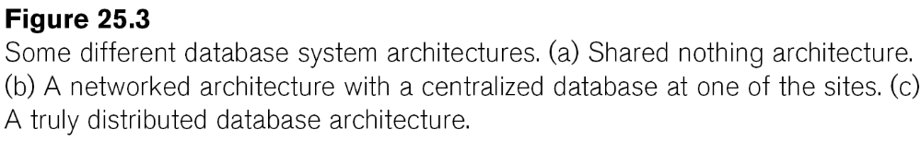
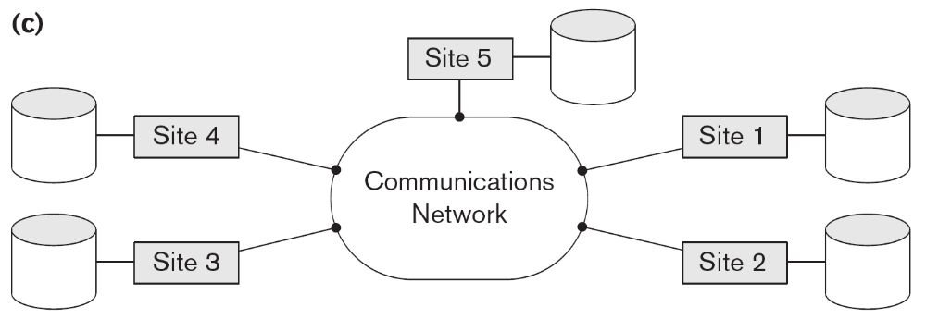
Distributed Database System
Advantages
  Management of distributed data with different levels of transparency:
    This refers to the physical placement of data (files, relations, etc.) which is not known to the user (distribution transparency).

Slide 4
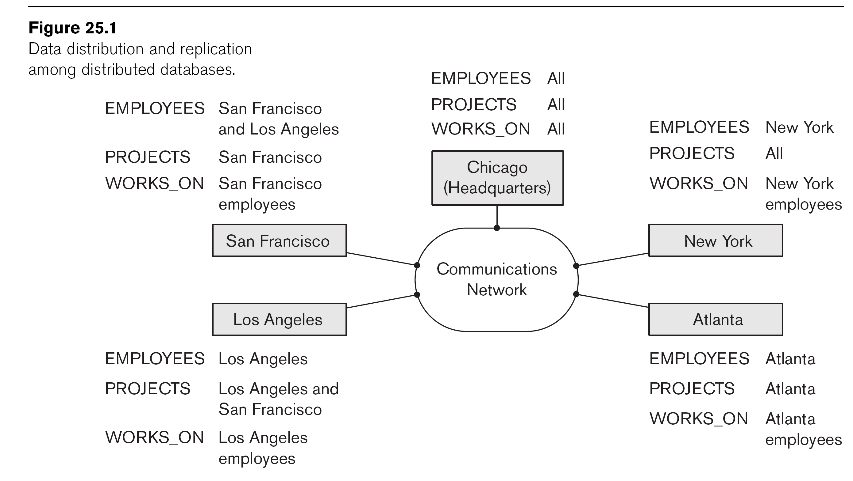
Distributed Database System
Advantages (transparency, contd.)
  The EMPLOYEE, PROJECT, and WORKS_ON tables may be fragmented horizontally and stored with possible replication as shown below.

Slide 5
Distributed Database System
Advantages (transparency, contd.)
  Distribution and Network transparency:
    Users do not have to worry about operational details of the network.
      There is Location transparency, which refers to freedom of issuing command from any location without affecting its working.
      Then there is Naming transparency, which allows access to any names object (files, relations, etc.) from any location.

Slide 6
Distributed Database System
Advantages (transparency, contd.)
  Replication transparency:
    It allows to store copies of a data at multiple sites as shown in the above diagram.
    This is done to minimize access time to the required data.
  Fragmentation transparency:
    Allows to fragment a relation horizontally (create a subset of tuples of a relation) or vertically (create a subset of columns of a relation).

Slide 7
Distributed Database System
Other Advantages
  Increased reliability and availability:
    Reliability refers to system live time, that is, system is running efficiently most of the time. Availability is the probability that the system is continuously available (usable or accessible) during a time interval.
    A distributed database system has multiple nodes (computers) and if one fails then others are available to do the job.

Slide 8
Distributed Database System
Other Advantages (contd.)
  Improved performance:
    A distributed DBMS fragments the database to keep data closer to where it is needed most.
    This reduces data management (access and modification) time significantly.
  Easier expansion (scalability):
    Allows new nodes (computers) to be added anytime without chaining the entire configuration.

Slide 9
Data Fragmentation, Replication and Allocation
Data Fragmentation
  Split a relation into logically related and correct parts. A relation can be fragmented in two ways:
    Horizontal Fragmentation
    Vertical Fragmentation

Slide 10
Data Fragmentation, Replication and Allocation
Horizontal fragmentation
  It is a horizontal subset of a relation which contain those of tuples which satisfy selection conditions.
  Consider the Employee relation with selection condition (DNO = 5). All tuples satisfy this condition will create a subset which will be a horizontal fragment of Employee relation.
  A selection condition may be composed of several conditions connected by AND or OR.
  Derived horizontal fragmentation: It is the partitioning of a primary relation to other secondary relations which are related with Foreign keys.

Slide 11
Data Fragmentation, Replication and Allocation
Vertical fragmentation
  It is a subset of a relation which is created by a subset of columns. Thus a vertical fragment of a relation will contain values of selected columns. There is no selection condition used in vertical fragmentation.
  Consider the Employee relation. A vertical fragment of can be created by keeping the values of Name, Bdate, Sex, and Address.
  Because there is no condition for creating a vertical fragment, each fragment must include the primary key attribute of the parent relation Employee. In this way all vertical fragments of a relation are connected.

Slide 12
Data Fragmentation, Replication and Allocation
Representation
  Horizontal fragmentation
    Each horizontal fragment on a relation can be specified by a σ_{Ci} (R) operation in the relational algebra.
    Complete horizontal fragmentation
    A set of horizontal fragments whose conditions C1, C2, …, Cn include all the tuples in R- that is, every tuple in R satisfies (C1 OR C2 OR … OR Cn).
    Disjoint complete horizontal fragmentation: No tuple in R satisfies (Ci AND Cj) where i ≠ j.
    To reconstruct R from horizontal fragments a UNION is applied.

Slide 13
Data Fragmentation, Replication and Allocation
Representation
  Vertical fragmentation
    A vertical fragment on a relation can be specified by a Π_{Li}(R) operation in the relational algebra.
    Complete vertical fragmentation
    A set of vertical fragments whose projection lists L1, L2, …, Ln include all the attributes in R but share only the primary key of R. In this case the projection lists satisfy the following two conditions:
    L1 ∪ L2 ∪ ... ∪ Ln = ATTRS (R)
    Li ∩ Lj = PK(R) for any i j, where ATTRS (R) is the set of attributes of R and PK(R) is the primary key of R.
    To reconstruct R from complete vertical fragments a OUTER UNION is applied.

Slide 14
Data Fragmentation, Replication and Allocation
Representation
  Mixed (Hybrid) fragmentation
    A combination of Vertical fragmentation and Horizontal fragmentation.
    This is achieved by SELECT-PROJECT operations which is represented by Π_{Li}(σ_{Ci} (R)).
    If C = True (Select all tuples) and L ≠ ATTRS(R), we get a vertical fragment, and if C ≠ True and L ≠ ATTRS(R), we get a mixed fragment.
    If C = True and L = ATTRS(R), then R can be considered a fragment.

Slide 15
Data Fragmentation, Replication and Allocation
Fragmentation schema
  A definition of a set of fragments (horizontal or vertical or horizontal and vertical) that includes all attributes and tuples in the database that satisfies the condition that the whole database can be reconstructed from the fragments by applying some sequence of UNION (or OUTER JOIN) and UNION operations.
Allocation schema
  It describes the distribution of fragments to sites of distributed databases. It can be fully or partially replicated or can be partitioned.

Slide 16
Data Fragmentation, Replication and Allocation
Data Replication
  Database is replicated to all sites.
  In full replication the entire database is replicated and in partial replication some selected part is replicated to some of the sites.
  Data replication is achieved through a replication schema.
Data Distribution (Data Allocation)
  This is relevant only in the case of partial replication or partition.
  The selected portion of the database is distributed to the database sites.

Slide 17
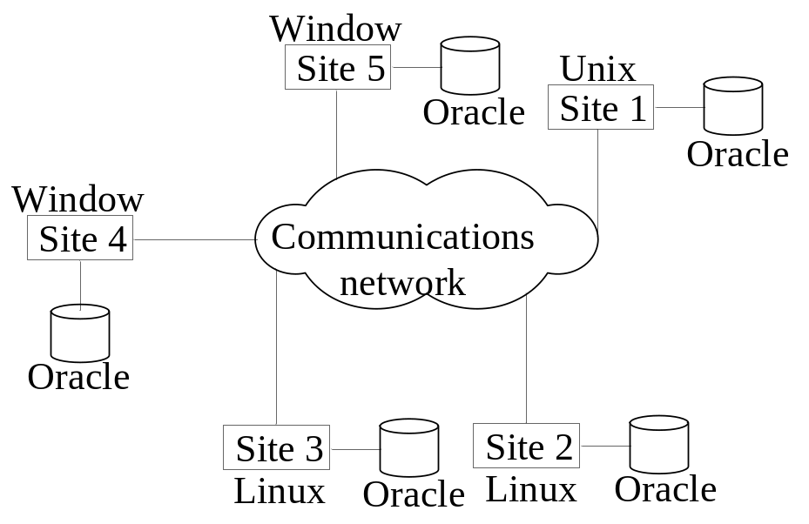
Types of Distributed Database Systems
Homogeneous
  All sites of the database system have identical setup, i.e., same database system software.
  The underlying operating system may be different.
    For example, all sites run Oracle or DB2, or Sybase or some other database system.
  The underlying operating systems can be a mixture of Linux, Window, Unix, etc.

Slide 18
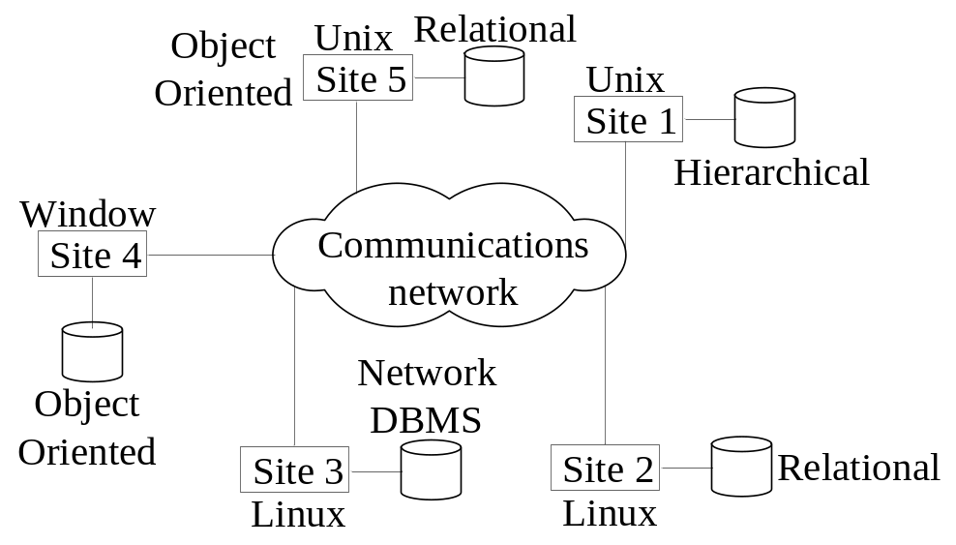
Types of Distributed Database Systems
Heterogeneous
  Federated: Each site may run different database system but the data access is managed through a single conceptual schema.
    This implies that the degree of local autonomy is minimum. Each site must adhere to a centralized access policy. There may be a global schema.
  Multidatabase: There is no one conceptual global schema. For data access a schema is constructed dynamically as needed by the application software.

Slide 19
Types of Distributed Database Systems
Federated Database Management Systems Issues
  Differences in data models:
    Relational, Objected oriented, hierarchical, network, etc.
  Differences in constraints:
    Each site may have their own data accessing and processing constraints.
  Differences in query language:
    Some site may use SQL, some may use SQL-89, some may use SQL-92, and so on.

Slide 20

Query Processing in Distributed Databases
Issues
  Cost of transferring data (files and results) over the network.
    This cost is usually high so some optimization is necessary.
    Example relations: Employee at site 1 and Department at Site 2
      Employee at site 1. 10,000 rows. Row size = 100 bytes. Table size = 10⁶ bytes.
      Department at Site 2. 100 rows. Row size = 35 bytes. Table size = 3,500 bytes.
    Q: For each employee, retrieve employee name and department name Where the employee works.
    Q: Π_{Fname,Lname,Dname} (Employee _{Dno = Dnumber} Department)
Fname | Minit | Lname | SSN | Bdate | Address | Sex | Salary | Superssn | Dno
Dname | Dnumber | Mgrssn | Mgrstartdate

Slide 21
Query Processing in Distributed Databases
Result
  The result of this query will have 10,000 tuples, assuming that every employee is related to a department.
  Suppose each result tuple is 40 bytes long. The query is submitted at site 3 and the result is sent to this site.
  Problem: Employee and Department relations are not present at site 3.

Slide 22
Query Processing in Distributed Databases
Strategies:
  Transfer Employee and Department to site 3.
    Total transfer bytes = 1,000,000 + 3500 = 1,003,500 bytes.
  Transfer Employee to site 2, execute join at site 2 and send the result to site 3.
    Query result size = 40 * 10,000 = 400,000 bytes. Total transfer size = 400,000 + 1,000,000 = 1,400,000 bytes.
  Transfer Department relation to site 1, execute the join at site 1, and send the result to site 3.
    Total bytes transferred = 400,000 + 3500 = 403,500 bytes.
Optimization criteria: minimizing data transfer.

Slide 23
Query Processing in Distributed Databases
Strategies:
  Transfer Employee and Department to site 3.
    Total transfer bytes = 1,000,000 + 3500 = 1,003,500 bytes.
  Transfer Employee to site 2, execute join at site 2 and send the result to site 3.
    Query result size = 40 * 10,000 = 400,000 bytes. Total transfer size = 400,000 + 1,000,000 = 1,400,000 bytes.
  Transfer Department relation to site 1, execute the join at site 1, and send the result to site 3.
    Total bytes transferred = 400,000 + 3500 = 403,500 bytes.
Optimization criteria: minimizing data transfer.
  Preferred approach: strategy 3.

Slide 24
Query Processing in Distributed Databases
Consider the query
  Q’: For each department, retrieve the department name and the name of the department manager
Relational Algebra expression:
  Π_{Fname,Lname,Dname} (Employee _{Mgrssn = SSN} Department)

Slide 25
Query Processing in Distributed Databases
The result of this query will have 100 tuples, assuming that every department has a manager, the execution strategies are:
  Transfer Employee and Department to the result site and perform the join at site 3.
    Total bytes transferred = 1,000,000 + 3500 = 1,003,500 bytes.
  Transfer Employee to site 2, execute join at site 2 and send the result to site 3. Query result size = 40 * 100 = 4000 bytes.
    Total transfer size = 4000 + 1,000,000 = 1,004,000 bytes.
  Transfer Department relation to site 1, execute join at site 1 and send the result to site 3.
    Total transfer size = 4000 + 3500 = 7500 bytes.

Slide 26
Query Processing in Distributed Databases
The result of this query will have 100 tuples, assuming that every department has a manager, the execution strategies are:
  Transfer Employee and Department to the result site and perform the join at site 3.
    Total bytes transferred = 1,000,000 + 3500 = 1,003,500 bytes.
  Transfer Employee to site 2, execute join at site 2 and send the result to site 3. Query result size = 40 * 100 = 4000 bytes.
    Total transfer size = 4000 + 1,000,000 = 1,004,000 bytes.
  Transfer Department relation to site 1, execute join at site 1 and send the result to site 3.
    Total transfer size = 4000 + 3500 = 7500 bytes.
Preferred strategy: Choose strategy 3.

Slide 27
Query Processing in Distributed Databases
Now suppose the result site is 2. Possible strategies :
  Transfer Employee relation to site 2, execute the query and present the result to the user at site 2.
    Total transfer size = 1,000,000 bytes for both queries Q and Q’.
  Transfer Department relation to site 1, execute join at site 1 and send the result back to site 2.
    Total transfer size for Q = 400,000 + 3500 = 403,500 bytes and for Q’ = 4000 + 3500 = 7500 bytes.

Slide 28
Query Processing in Distributed Databases
Semijoin:
  Objective is to reduce the number of tuples in a relation before transferring it to another site.
Example execution of Q or Q’:
  Project the join attributes of Department at site 2, and transfer them to site 1. For Q, 4 * 100 = 400 bytes are transferred and for Q’, 9 * 100 = 900 bytes are transferred.
  Join the transferred file with the Employee relation at site 1, and transfer the required attributes from the resulting file to site 2. For Q, 34 * 10,000 = 340,000 bytes are transferred and for Q’, 39 * 100 = 3900 bytes are transferred.
  Execute the query by joining the transferred file with Department and present the result to the user at site 2.

Slide 29
Concurrency Control and Recovery
Distributed Databases encounter a number of concurrency control and recovery problems which are not present in centralized databases. Some of them are listed below.
  Dealing with multiple copies of data items
  Failure of individual sites
  Communication link failure
  Distributed commit
  Distributed deadlock

Slide 30
Concurrency Control and Recovery
Details
  Dealing with multiple copies of data items:
    The concurrency control must maintain global consistency. Likewise the recovery mechanism must recover all copies and maintain consistency after recovery.
  Failure of individual sites:
    Database availability must not be affected due to the failure of one or two sites and the recovery scheme must recover them before they are available for use.

Slide 31
Concurrency Control and Recovery
Details (contd.)
  Communication link failure:
    This failure may create network partition which would affect database availability even though all database sites may be running.
  Distributed commit:
    A transaction may be fragmented and they may be executed by a number of sites. This require a two or three-phase commit approach for transaction commit.
  Distributed deadlock:
    Since transactions are processed at multiple sites, two or more sites may get involved in deadlock. This must be resolved in a distributed manner.

Slide 32
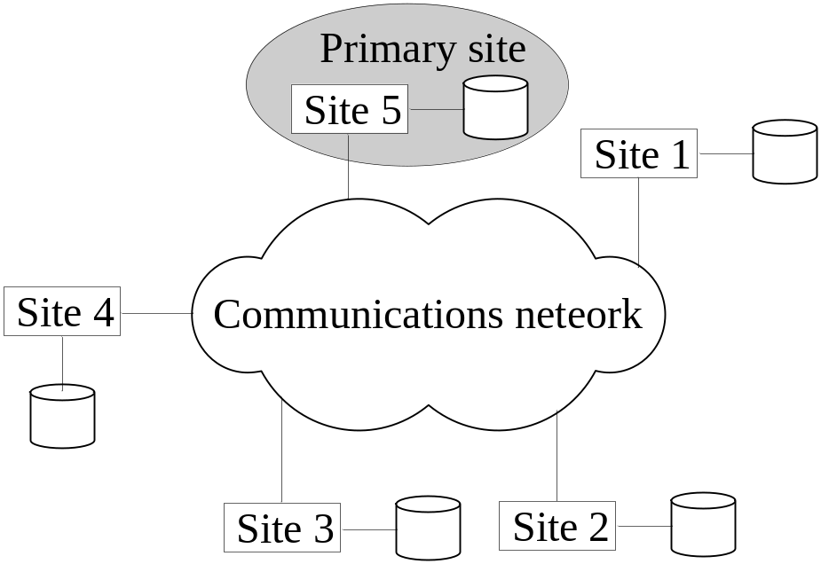
Concurrency Control and Recovery
Distributed Concurrency control based on a distributed copy of a data item
  Primary site technique: A single site is designated as a primary site which serves as a coordinator for transaction management.

Slide 33
Concurrency Control and Recovery
Transaction management:
  Concurrency control and commit are managed by this site.
  In two phase locking, this site manages locking and releasing data items. If all transactions follow two-phase policy at all sites, then serializability is guaranteed.

Slide 34
Concurrency Control and Recovery
Transaction Management
  Advantages:
    An extension to the centralized two phase locking so implementation and management is simple.
    Data items are locked only at one site but they can be accessed at any site.
  Disadvantages:
    All transaction management activities go to primary site which is likely to overload the site.
    If the primary site fails, the entire system is inaccessible.
  To aid recovery a backup site is designated which behaves as a shadow of primary site. In case of primary site failure, backup site can act as primary site.

Slide 35
Concurrency Control and Recovery
Primary Copy Technique:
  In this approach, instead of a site, a data item partition is designated as primary copy. To lock a data item just the primary copy of the data item is locked.
Advantages:
  Since primary copies are distributed at various sites, a single site is not overloaded with locking and unlocking requests.
Disadvantages:
  Identification of a primary copy is complex. A distributed directory must be maintained, possibly at all sites.

Slide 36
Concurrency Control and Recovery
Recovery from a coordinator failure
  In both approaches a coordinator site or copy may become unavailable. This will require the selection of a new coordinator.
Primary site approach with no backup site:
  Aborts and restarts all active transactions at all sites. Elects a new coordinator and initiates transaction processing.
Primary site approach with backup site:
  Suspends all active transactions, designates the backup site as the primary site and identifies a new back up site. Primary site receives all transaction management information to resume processing.
Primary and backup sites fail or no backup site:
  Use election process to select a new coordinator site.

Slide 37
Concurrency Control and Recovery
Concurrency control based on voting:
  There is no primary copy of coordinator.
  Send lock request to sites that have data item.
  If majority of sites grant lock then the requesting transaction gets the data item.
  Locking information (grant or denied) is sent to all these sites.
  To avoid unacceptably long wait, a time-out period is defined. If the requesting transaction does not get any vote information then the transaction is aborted.

Slide 38
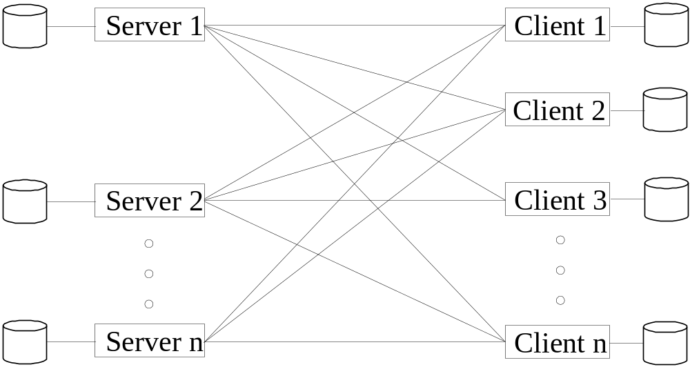
Client-Server Database Architecture
It consists of clients running client software, a set of servers which provide all database functionalities and a reliable communication infrastructure.

Slide 39
Client-Server Database Architecture
Clients reach server for desired service, but server does reach clients.
The server software is responsible for local data management at a site, much like centralized DBMS software.
The client software is responsible for most of the distribution function.
The communication software manages communication among clients and servers.

Slide 40
Client-Server Database Architecture
The processing of a SQL queries goes as follows:
  Client parses a user query and decomposes it into a number of independent sub-queries. Each subquery is sent to appropriate site for execution.
  Each server processes its query and sends the result to the client.
  The client combines the results of subqueries and produces the final result.

Slide 41
Recap
Distributed Database Concepts
Data Fragmentation, Replication and Allocation
Types of Distributed Database Systems
Query Processing
Concurrency Control and Recovery
3-Tier Client-Server Architecture

